Slide 1
MediaRockerzz A Media Player Application
Project
Object-Oriented methodologies

Slide 2
TABLE OF CONTENTS
TEAM MEMBERS
ABOUT THE PROJECT
FEATURES
HOW IT WORKS
POTENTIAL FOR FUTURE IMPROVEMENT
USE CASE DIAGRAM
USE CASE DIAGRAM EXPLANATION
CLASS DIAGRAM
CRC DIAGRAM
SNEAK PEAK

Slide 3
TEAM MEMBERS OF GROUP 100
KUNDAN KUMAR (IIT2021062 SECTION-A)
DEEPAK VERMA (IIT2021063 SECTION-A)
ADITYA YALAMANCHI (IIB2021001 SECTION-C)

Slide 4

ABOUT THE PROJECT
Our project is a media player that can play both audio and video.
It was developed using Java fx and Java fxml.
The project is motivated by a flawless user experience and a clear and slick user interface.
We demonstrate some of the application's fundamental functions, such as playing media, adjusting the volume, skip forward or go backward , pausing, etc.

Slide 5
FEATURES
We have implemented the following things
A play and pause button
A volume slider
Forward and Backward (+ or – 10 sec)
Open :to open files
Exit :to exit the player

Slide 6
HOW IT WORKS (CLASS DIAGRAM VIEW)
The Application has a bunch of buttons.
These buttons have different features that can be applied during the usage of the media player.
The Open button will direct us to the computer directory where we select media file. If the media file is valid, then it will open.(controller class)
We can also control the volume by increasing or decreasing it using the slider. (Volume_increment_decrement class)
We can enter full screen by tapping twice.
Moving forward / backward in the video is also available.(Right_shift and Left_shift class)
(increase_playback_speed and decrease_playback_speed class) to increase speed of the forward/backward feature.
The media file playing can also be paused .(play_pause class)

Slide 7
THE POTENTIAL FOR FUTURE IMPROVEMENT
Improve the User Interface experience .
Add a favourites section .
Add a Watch later section .
A warning call that tells the user if the audio of the media he/she is playing is about to get loud .An option to disable this feature can also be provided.
Add a Playlist feature .

Slide 8
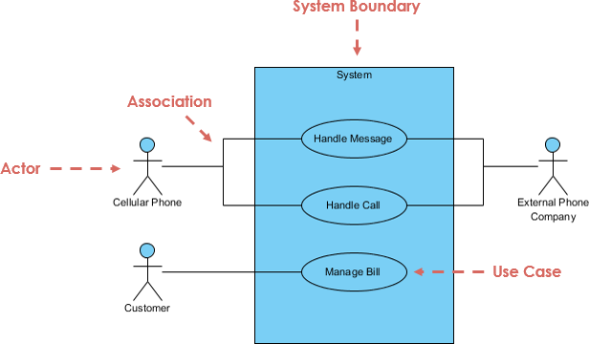
BASIC STRUCTURE OF A USE CASE DIAGRAM

Slide 9
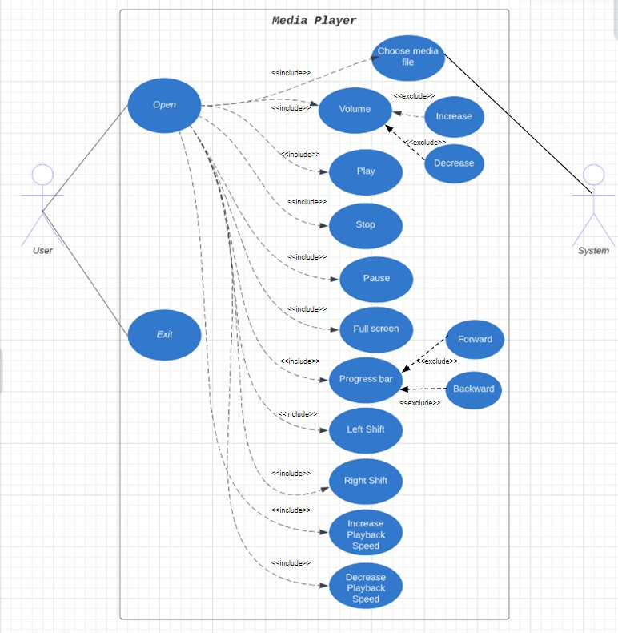
USE CASE DIAGRAM
<<extend>>
<<extend>>
<<extend>>
<<extend>>
<<extend>>

Slide 10
USE CASE DIAGRAM EXPLANATION
Open function gives way to various other functions for the user to use while using the application.
Choose media file function allows the user to select his/her desired media file
Volume function allows the user to control the volume using the extended function decrease and increase.
Play,pause and stop functions are also various options given to the user to apply on the media file playing.Full screen function to enter full screen is also available.
The Progress bar function displays the duration of the media file completed.The Forward and Backward functions extend this function.Left And Right Shift functions allow the user to go in both direction of the media file.
Increase and decrease playback functions allow the user to increase and decrease the playback speed of the media file.

Slide 11
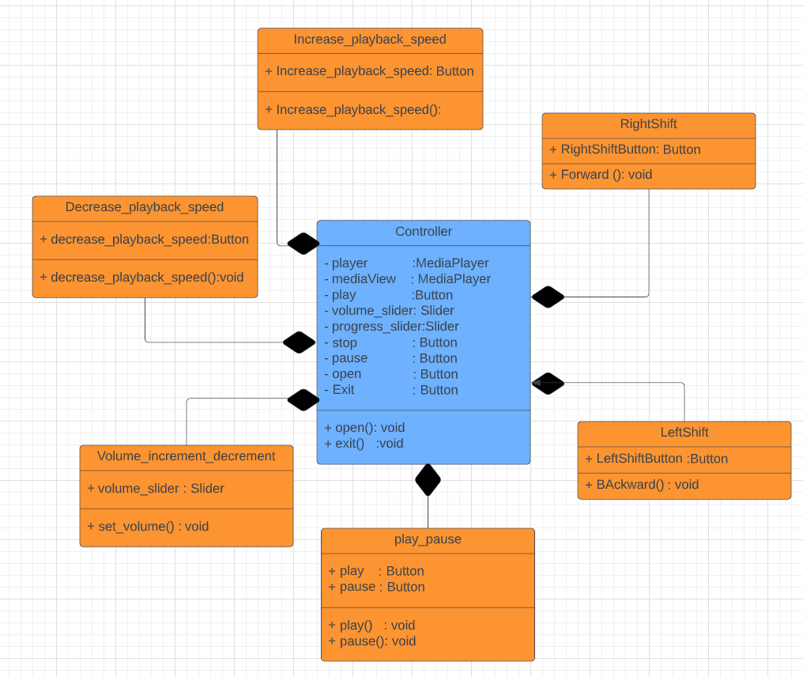
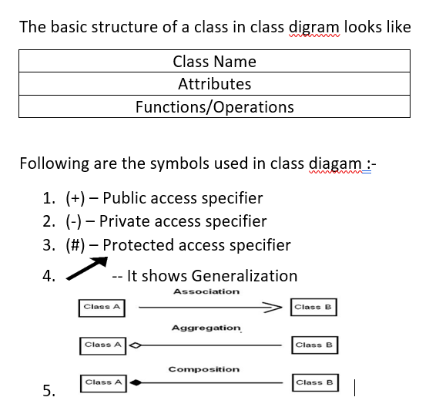
CLASS DIAGRAM
The basic structure of a Class diagram
Following are the symbols used in class diagram

Slide 12
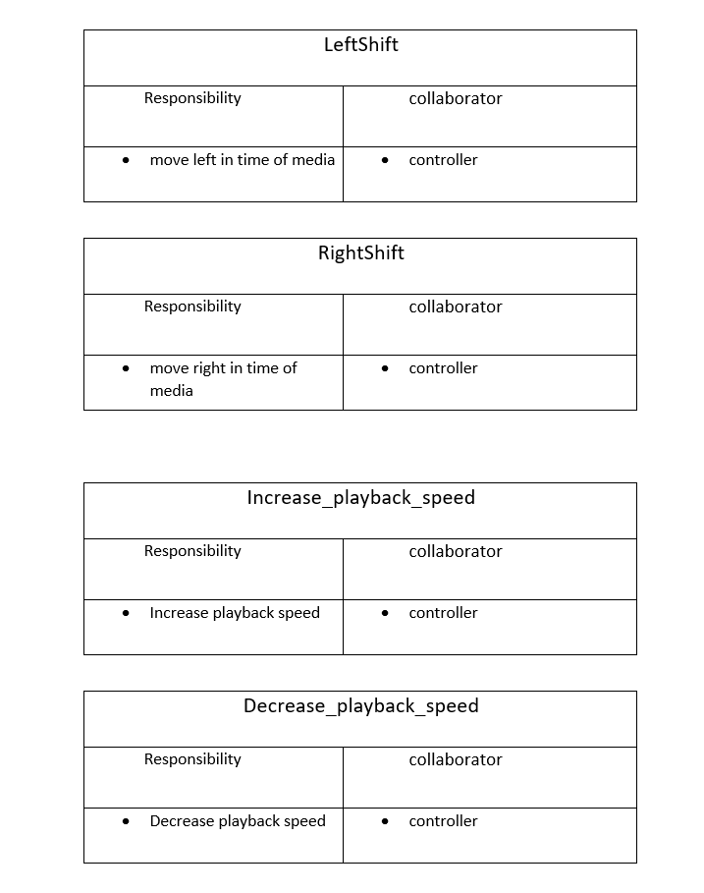
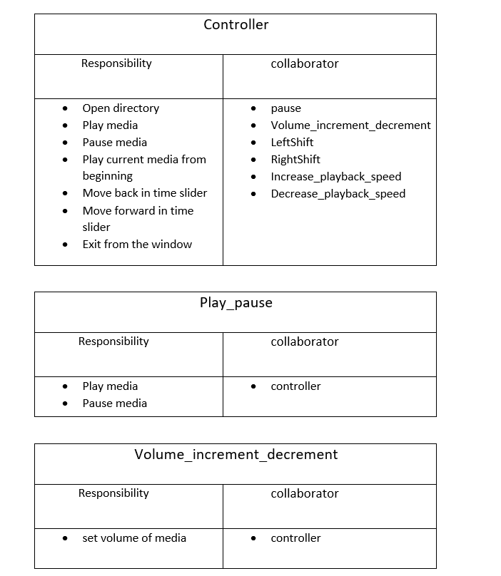
CRC DIAGRAM

Slide 13

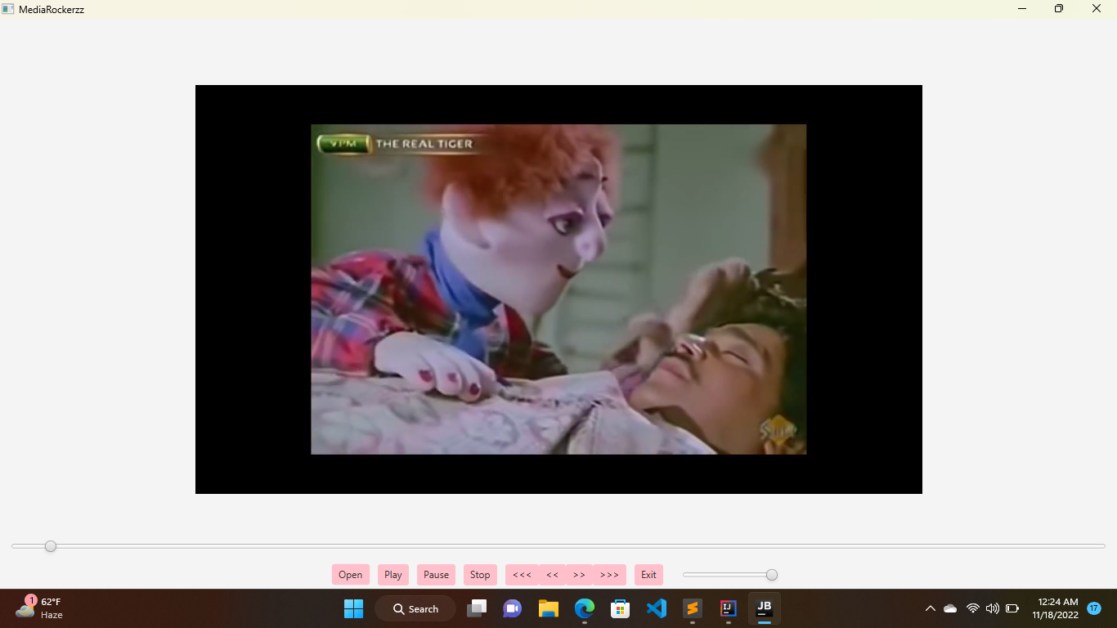
SNEAK PEAK

Slide 14
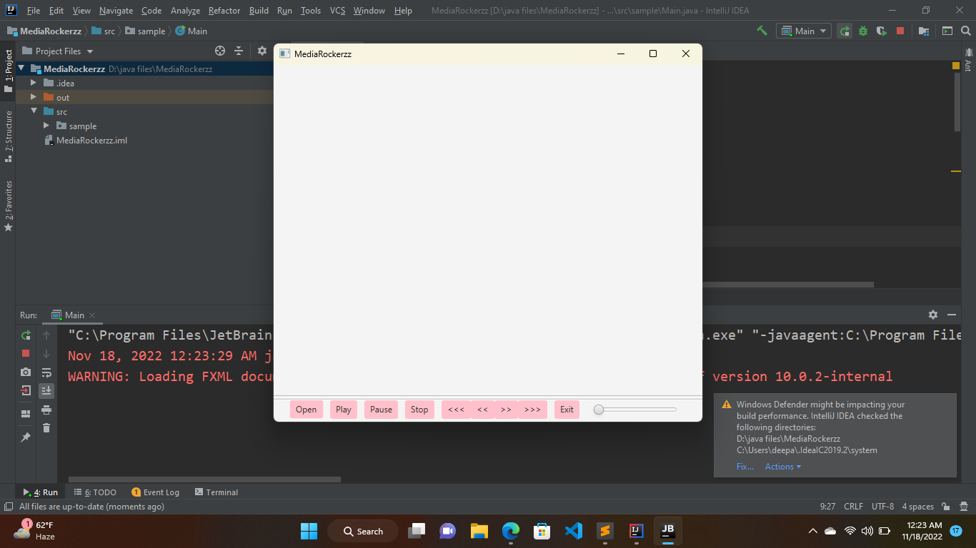
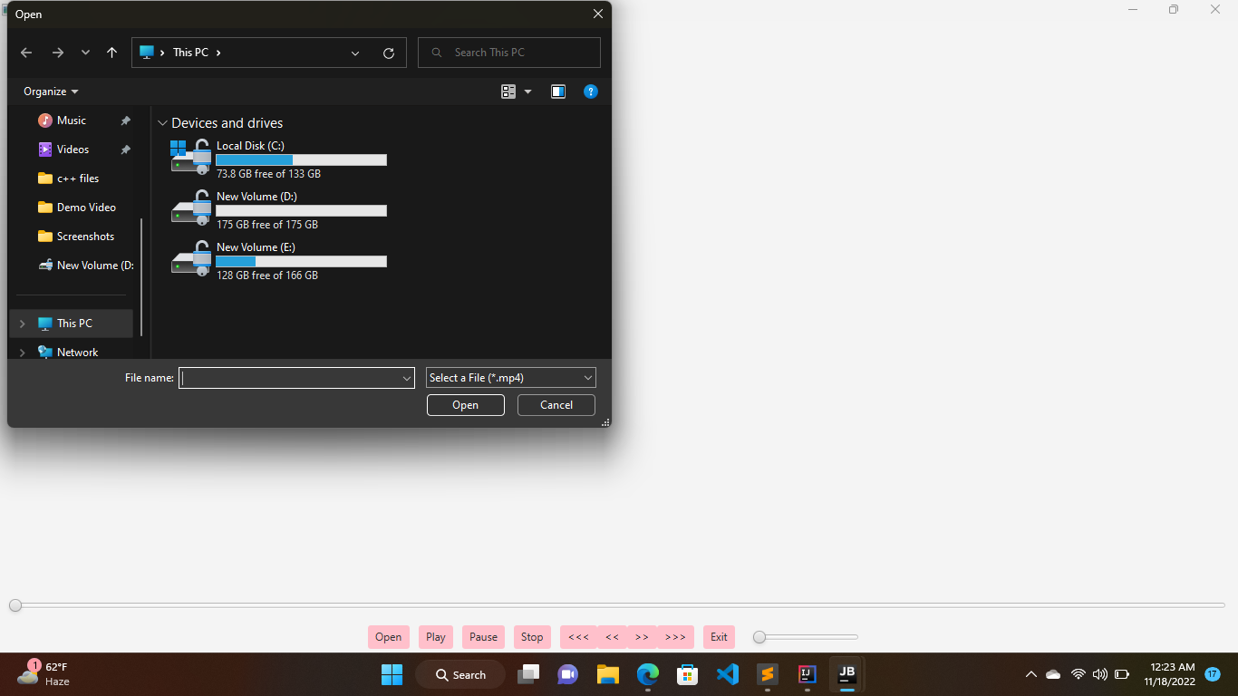
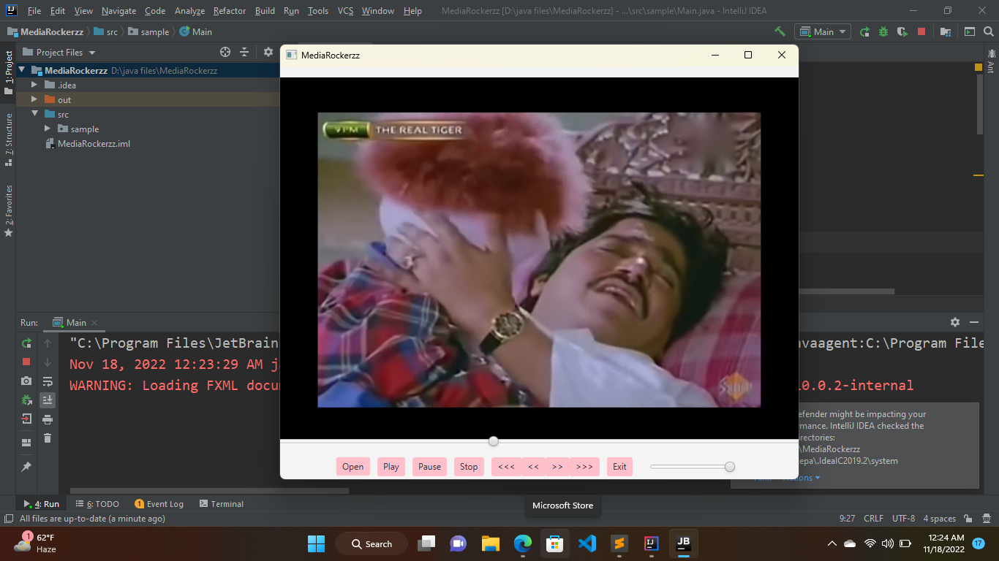
STEP I : OPEN THE PLAYER
STEP II : SELECT A FILE TO PLAY
ENJOY !!!
(Utilize the optional features according to your preferences.)

Slide 15
THANK YOU !!

